Slide 1
Empowerment Theatre as a tool for NFE & Inclusion
#Infusion Workshops
Bo Maria Daskalova, PhD
Dublin, June 27th 2024
"Immerge, engage, and innovate education"

Slide 2
…theatre answers man’s universal demand to have his feelings moved, the monotony of his life broken up, and his nobler self started into action. The drama, is therefore, inescapable in the social life and must be considered in education.” (Merill and Fleming, 1930).
Applied theatre has the ability to create individual, community and social change. And while the classical theatre brings a personal catharsis, the applied theatre creates a social catharsis; towards a positive social change.

Slide 3
About
This input is focusing on the method, called “Empowerment Theatre” - as a tool for education in non-formal settings.
Based on the Forum Theatre theory of Augusto Boal and the Pedagogy of the Oppressed of Paolo Freire, this educational method is invented by Bo Maria Daskalova, using participatory and emotional learning as powerful ways to boost the learners` motivation to learn and get involved; fostering social inclusion and personal development.

Slide 4
Key Points
The Concept of Empowerment Theatre
Foundations
Bertolt Brechts`s Theory of Epic Theatre
Pedagogy of the Oppressed of Paolo Freire
Theatre of the Oppressed of Augusto Boal
Growing from Boal`s concept of the Theatre of the Oppressed, the “Empowerment theatre” method seeks to transfer oppression into empowerment.
Methodological Aspects
Practical Applications
Adaptability and Multiplicativity
Applied theatre techniques offer fun, engaging and creative ways to create spaces for dialogue, exploration, and learning. They do not require any prior experience in theatre.
To empower participants with skills to discover and learn; to explore issues of concern to local communities; to provoke and shape social change.
The Empowerment Theater method offers an unique potential to be adapted to almost any adult learning situation that allows the groups to act together for common problem solutions. The tools of applied drama for empowerment are easy to use, adapt and multiply in a wide range of learning setting settings, communities and social contexts.

Slide 5
The EMPOWERMENT THEATRE Concept
The Empowerment Theatre uses applied drama methods as an empowering participatory adult learning experience, searching for social change, while mobilizing communities to take collective action for local solutions and positive community development.
The empowering experience of rehearsing real life problems and searching together for their social solutions in the brings participants beyond the emotional catharsis of the classical drama.
The Empowerment Theatre leads to a social catharsis, where the Oppressed are turned into Empowered in search for personal growth and community cohesion.

Slide 6
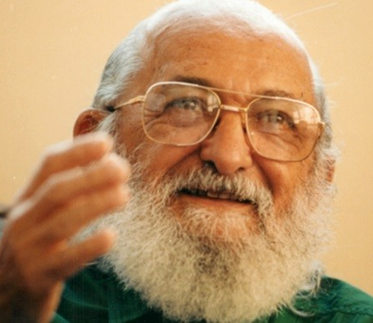
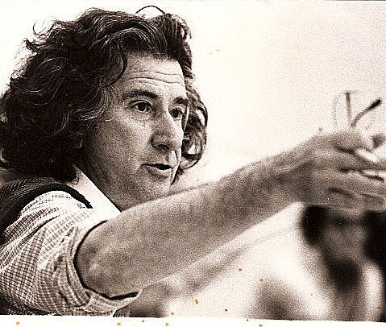
The Foundations
Bertolt Brechts`s Theory of Epic Theatre - focuses on the vital roles that theatre could play so as to change the situation towards the better.
Pedagogy of the Oppressed of Paolo Freire – focusing on the need for oppressed individuals to abandon their objectified position and fight for their liberation as human beings.
Theatre of the Oppressed of Augusto Boal - focuses less on performance or fiction and more on real- life solutions. The performers are called spect-actors because they are participants in the action and not just spectators.

Slide 7
The Method
Empowerment Theatre is an applied drama methodology that is an unique amalgam of participatory and inclusive techniques that create a space for dialogue, social inclision and exploration.
Empowerment Theatre does not focus on performance or fiction but on real-life solutions.
The performers are called spectACTors because they are participants in the action and not just passive spectators.
The active spectACTor is EMPOWERED - in a position to change the outcome of the drama with his/her-own actions.

Slide 8
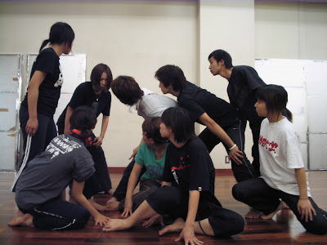
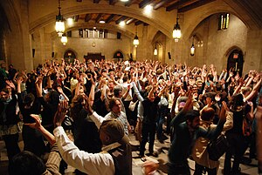
Applied Theatre in Action

Slide 9
The Practical Applications of Empowerment Theatre (ET)
The practical application of using ET methods could address the need:
- to discover and learn (in formal and mostly – non-formal learning settings);
- to explore issues of concern to local communities – mobilizing learning-by-doing and emotional learning methods;
- to identify problems and actively rehearse solutions in dramatized settings (play out the problem until you solve it);
- to provoke and shape social change with the active participation of all community members who act towards the change and shape it, according to their own needs.

Slide 10
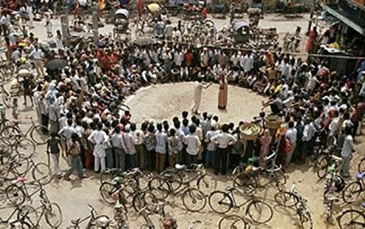
No Limits of Application

Slide 11
Adaptability and Multiplicativity
The Empowerment Theater method offers an unique potential to be adapted to almost any adult learning situation that allows the groups to act together for common problem solutions.
The tools of applied drama for empowerment are easy to use, adapt and multiply in a wide range of learning setting, communities, social and cultural contexts.
It it up to the facilitators to assess the social, cultural, educational and emotional context in order to offer the most suitable adaptation of the method, so it can serve best the learning and social needs of the community that is involved.

Slide 12
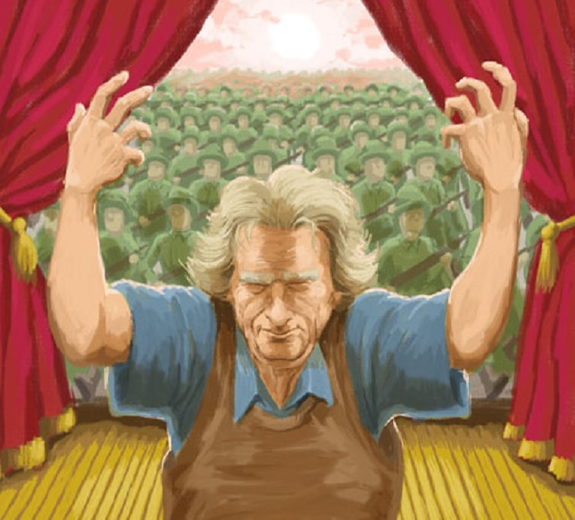
USEFUL LINKS https://www.youtube.com/watch?v=ANtkDBd9UNI&ab_channel=YOUTRAINvideoproject
https://www.youtube.com/watch?v=g04FxiuZd1s&ab_channel=PartecipArte

Slide 13
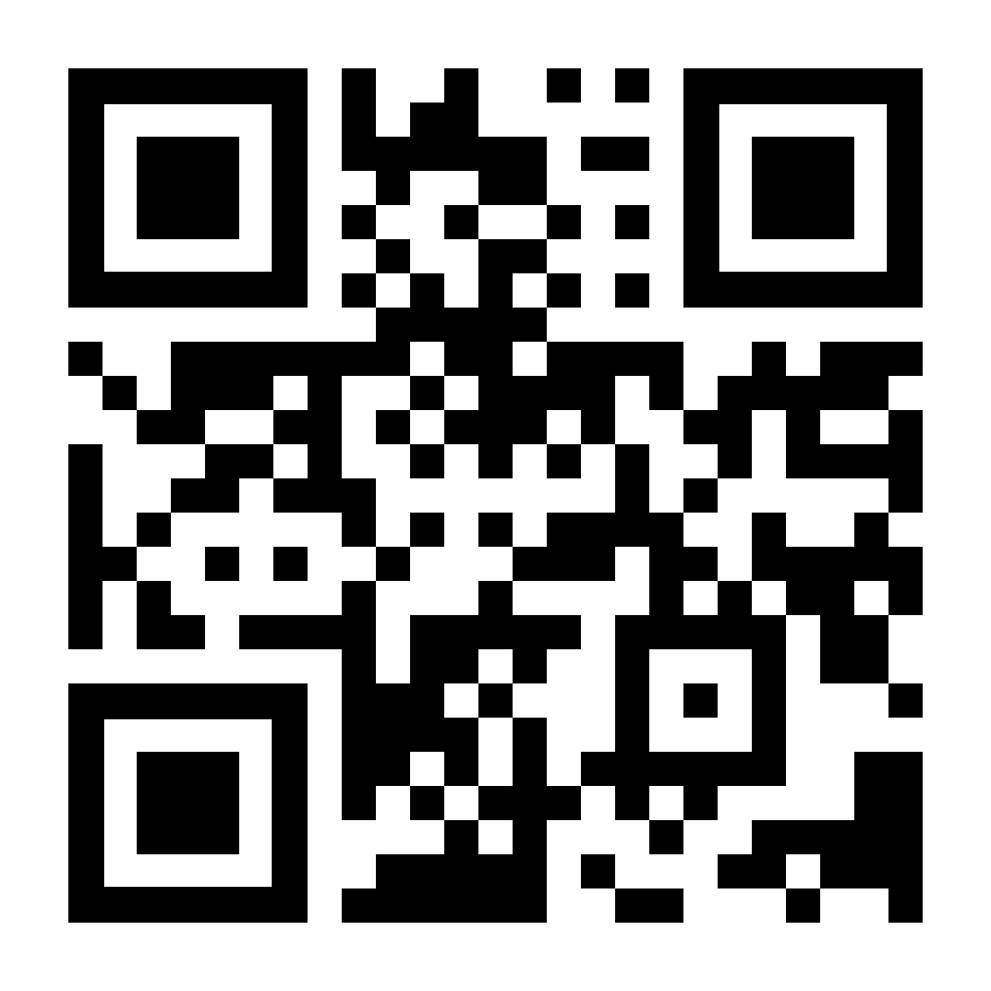
Thank you
Thanks to your time.
We look forward to working together.
More at
www.T-hap.com
For more information and opportunities to cooperate,
please consult: ictidc-ie.eu/theatre-of-the-empowred.html
Contact:
Bo Maria Daskalova, PhD
ictidcenter@gmail.com
#Infusion Workshops

